Slide 1


Kinaesthesia in virtual environments
Dipartimento di scienze sociali, politiche e cognitive
Corso di laurea in
Strategie e Tecniche della Comunicazione
Gamification through «Game Feel»
Relatore
Chiar.ma Prof.ssa Patrizia Marti
Controrelatore
Chiar.mo Prof. Alessandro Innocenti
Tesi di laurea di
Deborah Zanardi
Anno Accademico 2016/2017

Slide 2

Kinaesthesia
Awareness of the position and movement of the body in space.

Slide 3
The relation between body and technology involves kinaesthesia at least in three ways
Perception of the user own body in movement and his interaction with the physical interface
Extended embodiment
Kinesthetic interaction: engage the user both physically and socially with innovative modes of interaction.
Vision of virtual movement stimulate the viewer mirror-neuron system
Kinesthetic empathy
The embodied simulation that comes as a response to observed movement.
Kinesthetic empathy interaction: when the system opens up for the possibility of the users being able to read, decode and react on each other’s movements.
Control of a virtual object in the virtual space
Vicarious kinesthesia

Slide 4
“Gamification is the use of game design elements in non-game environments”
(Deterting et al., From Game Design Elements to Gamefulness: Defining “Gamification”)
A technique to change the users behaviour in conformance to the company strategy.
Reinforcement programs, typical of the Skinnerian operant conditioning.
A long-term investment based on extrinsic motivation
Leaderboard, badges, levels
Gamification
Kinesthetic game mechanics
Game Feel
A moment-to-moment, intrinsic pleasure that depends on the interaction itself.
Kinesthetic mechanics require psychomotor abilities,
non-kinesthetic mechanics require a cognitive ones.
(Karhulahti, 2013)

Slide 5



Gregersen and Grodal
«Embodiment and Interface
Three building blocks of Game Feel :
Real-time control over a virtual object;
Simulated space which is experienced directly through the controlled object;
Polish, tangible additional effects that help sell the physicality of the interaction;
Klevjer
«The role of the avatar»
Mouse-based interfaces
Symbolic interaction
Avatar-based interfaces
Tangible interaction
Vicarious kinesthetic is the combination of the flexibility of embodiment typical of expert tool-user and kinesthetic empathy.
vs
The avatar is not merely a means to interact with the interface but belongs to and is
exposed to its environment.
“One allows us to feel our own body extending into the virtual environment through a kind of virtual tool-use, the other activates our own motor system as a response to observed motor patterns”.
Steve Swink
«Game Feel»
The avatar cannot be intended just as a prosthesis, but must equally be intended as Other.
(Characterization through the way it moves)
A comprehensive model of vicarious kinesthetic

Slide 6
Speed of reaction
Kinesthetic empathy
between the command given by the tool and the response of the elements that elicit kinesthetic empathy.
Game Feel
Extended embodiment
Tangibility
Recreation of tactile and physical effect on the virtual interface.
Symbolic
Tangible
Mouse cursor
Avatar
Configuration of spaces
Association or dissociation between the plane in which the tool moves and that to which the other element of the interface pertain.
Tool plane
Objects plane
A comprehensive model of vicarious kinesthetic

Slide 7
The Archive
A gamified online library
The website will be an online archive the user will navigate and explore as it was a real library. The Archive will contain mainly novels and other books red as a free time activity. The preferred target will be young adults, but there will not be a limit of age to visit the website. The main product objective will be to foster individual reading, teasing their curiosity through a sense of exploration and mystery.

Slide 8
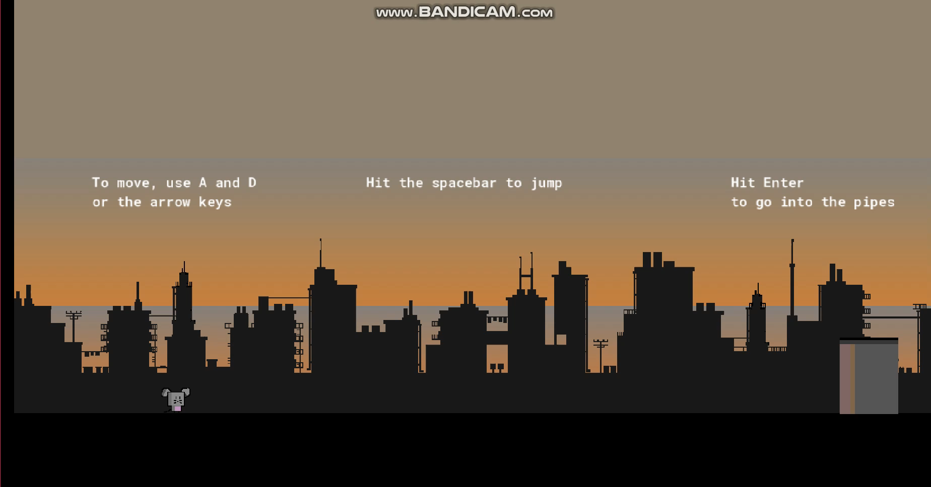
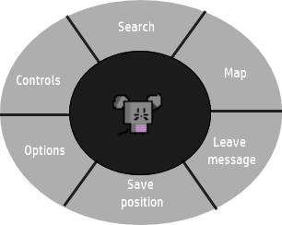
Gamification of the navigation
Platform game mechanics
Exploration mode
An example of gamification which uses kinesthetic game mechanics
Objective avatar (seen as an external object)
Speed of reaction
Tangibility
2d space
Avatar
Configuration of spaces
Tool plane
Objects plane
Contextual menu

Slide 9
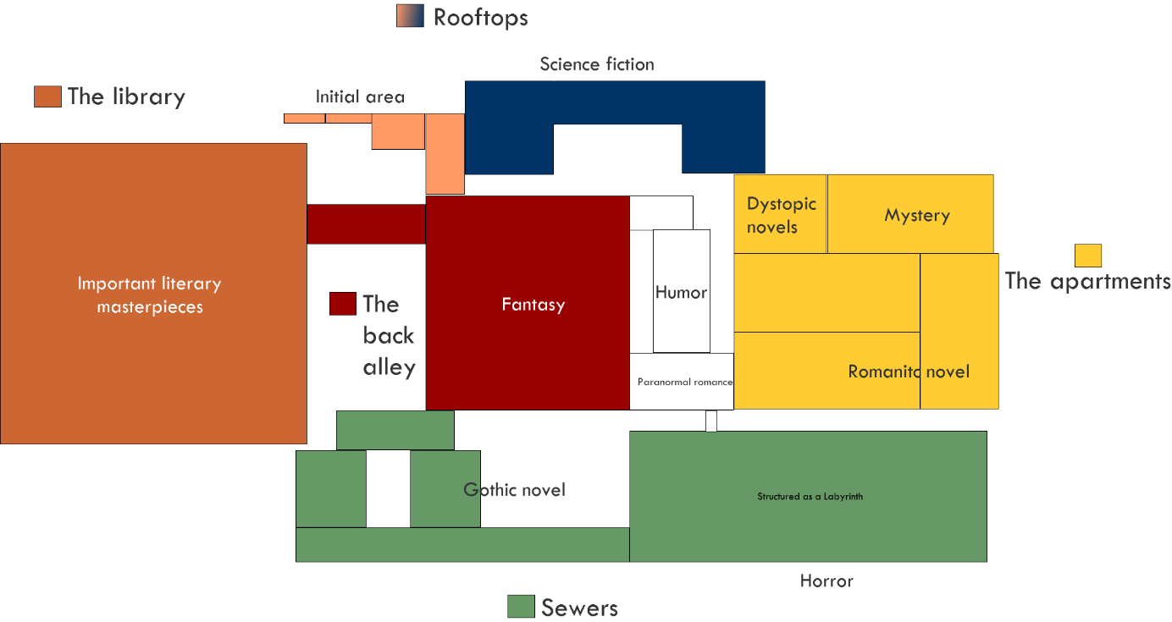
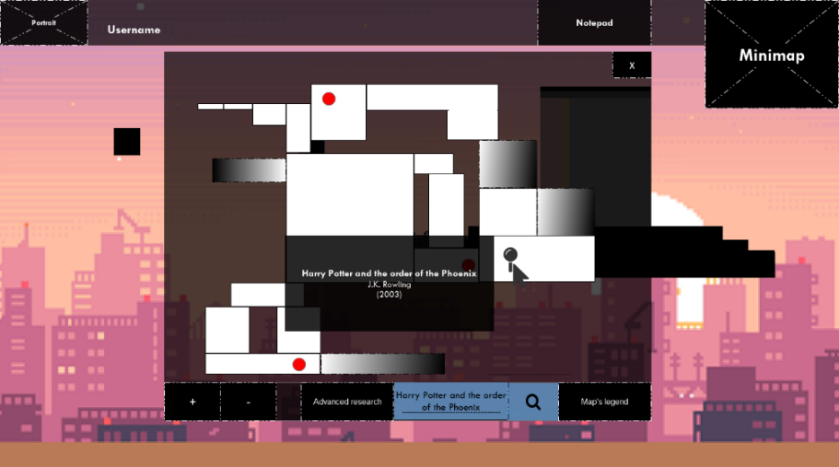
Gamification of the research of content
First time user are provided with an incomplete map. To fill the blanks, the user will actively explore the library.
The user browse the books on the website as it were a physical library
The library will be divided in sections which thematically reflect the literary genre they house.

Slide 10
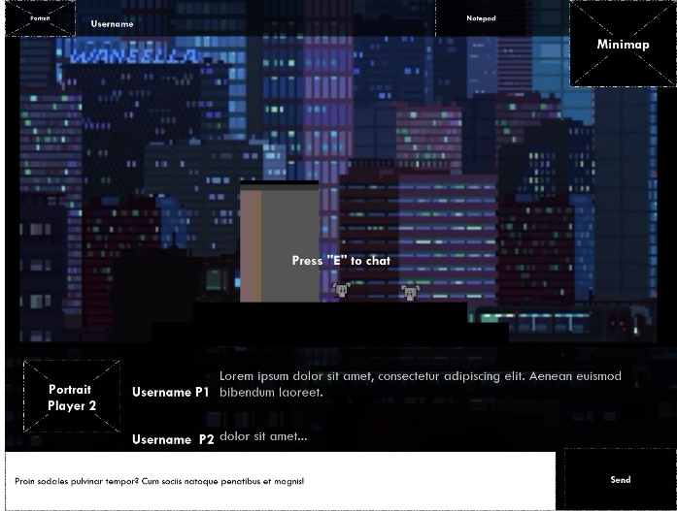
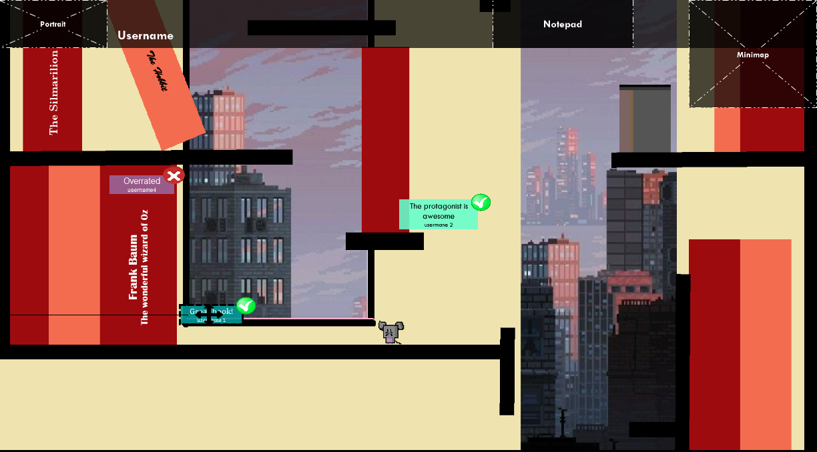
Social features
The user can encounter other players when exploring the library and chat with them.
He can also leave messages in the environment to suggest and comment on books.

Slide 11
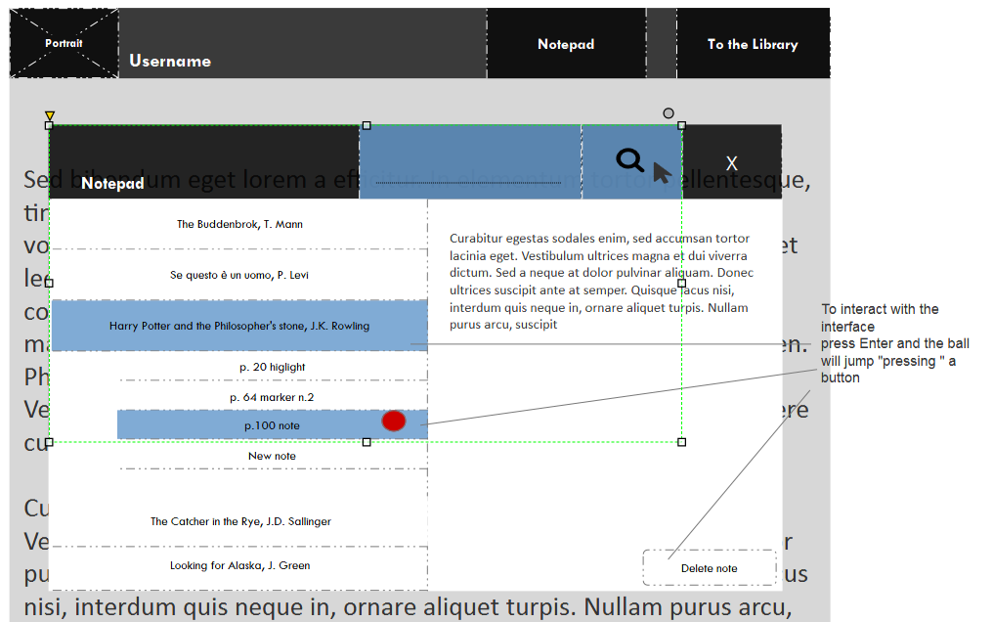
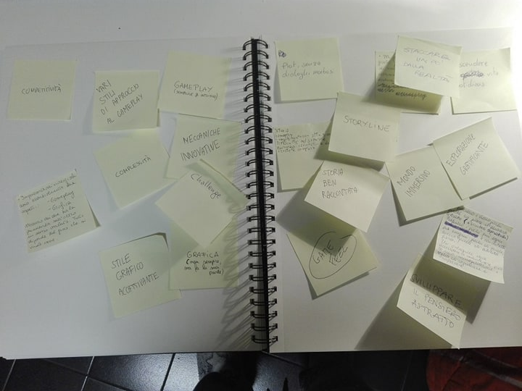
Co-design session
The design was then discussed with 6 expert users in a co-design session, which focused on the exploration mode.
Divergent phase:
Write down the reasons they enjoy games as a medium.
Central hub
Meet with peers and play minigames
Costumes and shortcuts as achievements
- Answer questions on the book to gain a new costume,
- Complete hard platforming section to unlock a shortcut to distant parts of the library.
User profiles
Show achievements and read books
Discussion phase:
Discuss how to apply them to the Archive.

Slide 12


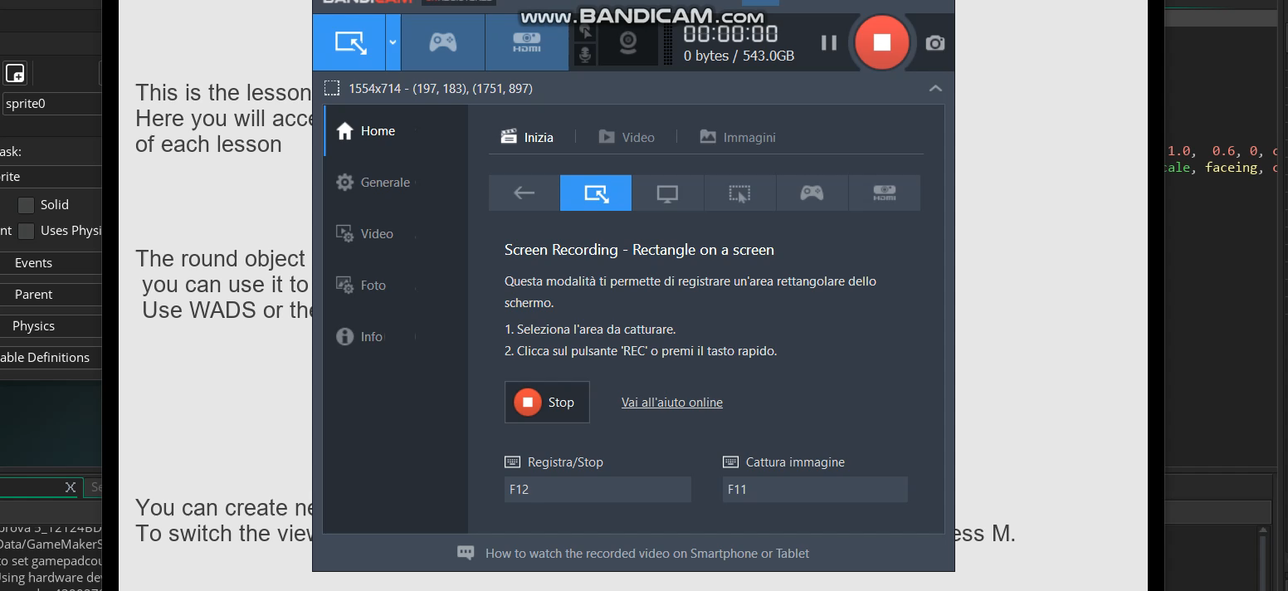
The user navigates the page using a “marker”. The marker is used to move the visualized text by “rolling” it through the page. The user can create multiple markers, to use them as bookmarks.
Lecture mode
Give kinetic properties to the instrument of interaction
With the marker the user interact with the text. Pressing Shift and moving, the marker leaves behind a trail that functions as highlighter. Pressing Enter, it select lines of text.
Speed of reaction
Abstract and objective avatar
Tangibility
Symbolic interaction with tangible effects
Marker
Configuration of spaces
Tool plane
Objects plane

Slide 13
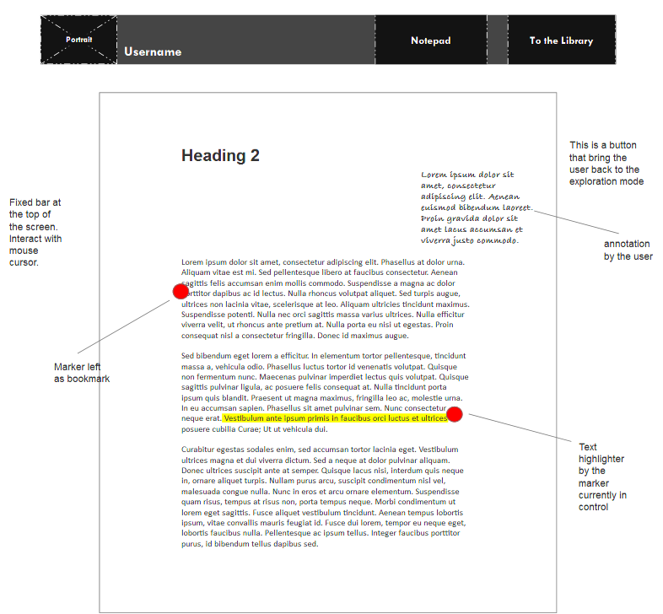
The marker positions and the annotation are saved in the Notepad, accessible also from the exploration mode.

Slide 14
Grazie a tutti per l’attenzione

Slide 15
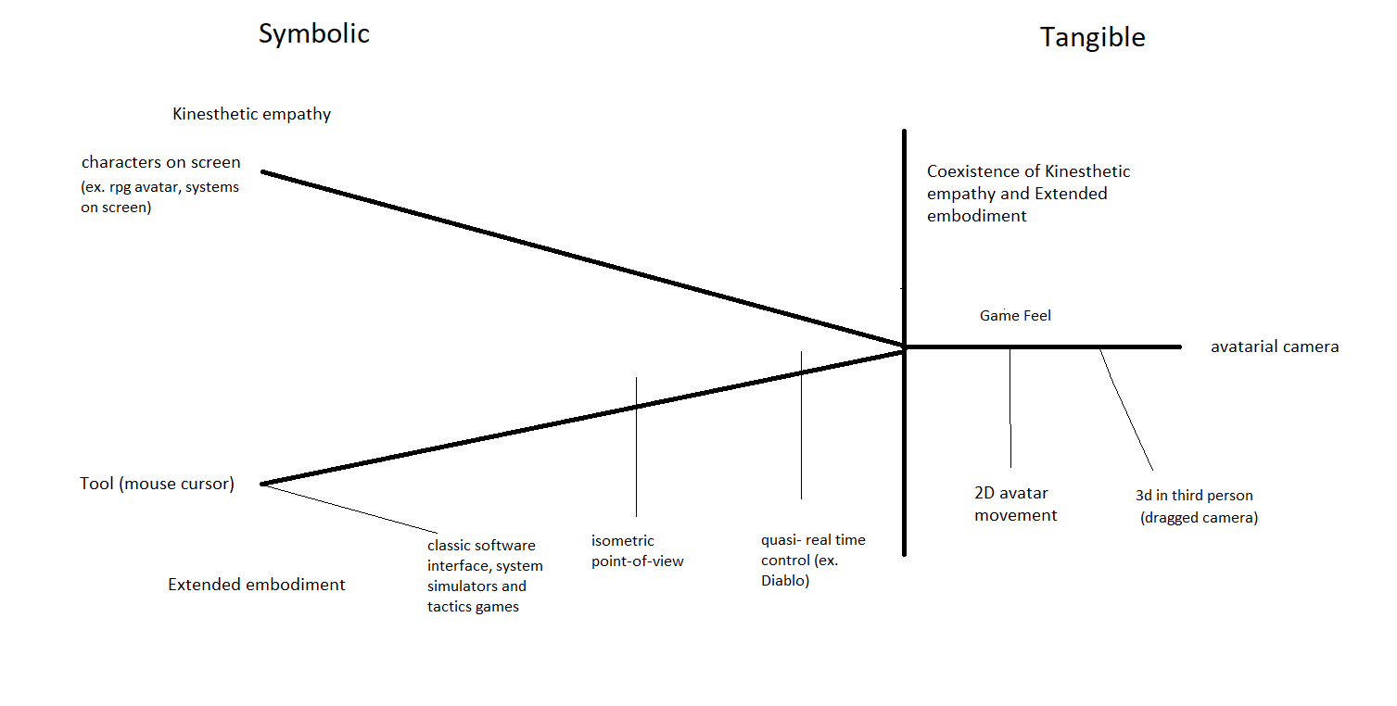

Slide 16
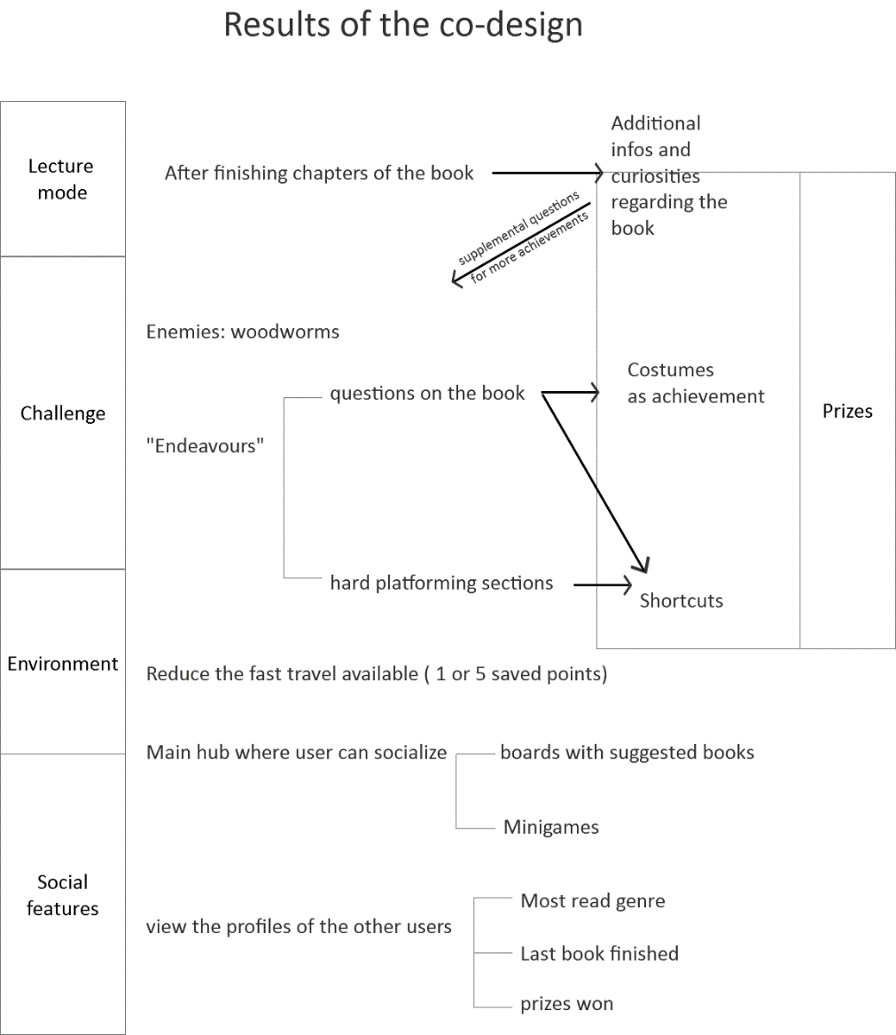

Slide 17
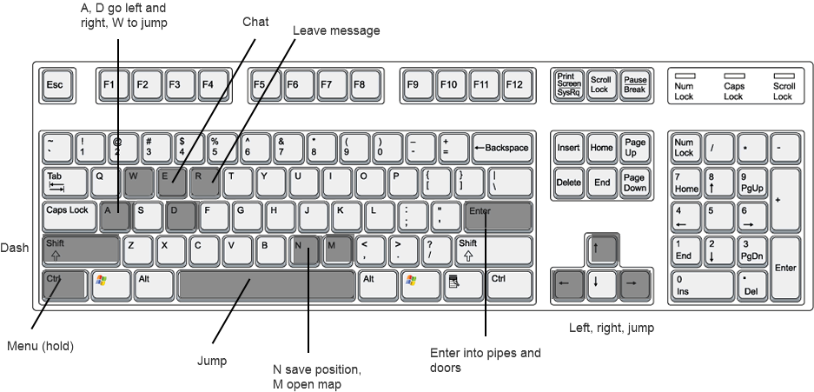
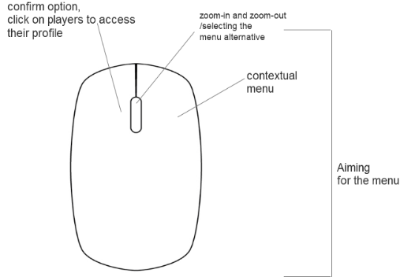
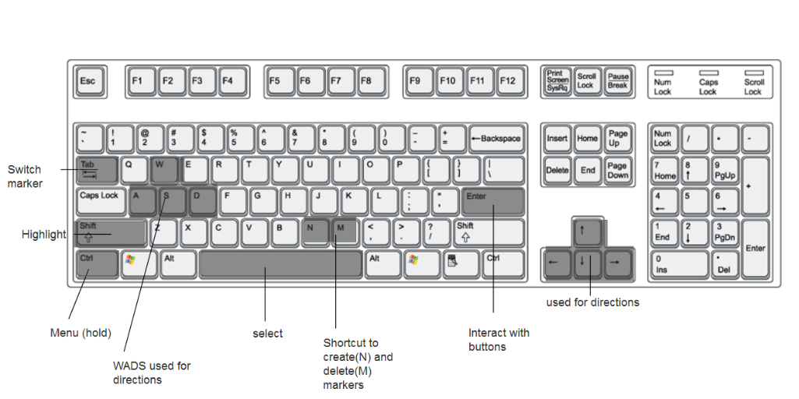
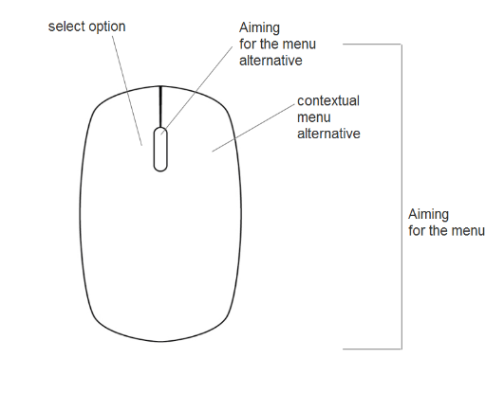
Controls Exploration mode
Controls
Lecture
mode

Slide 18
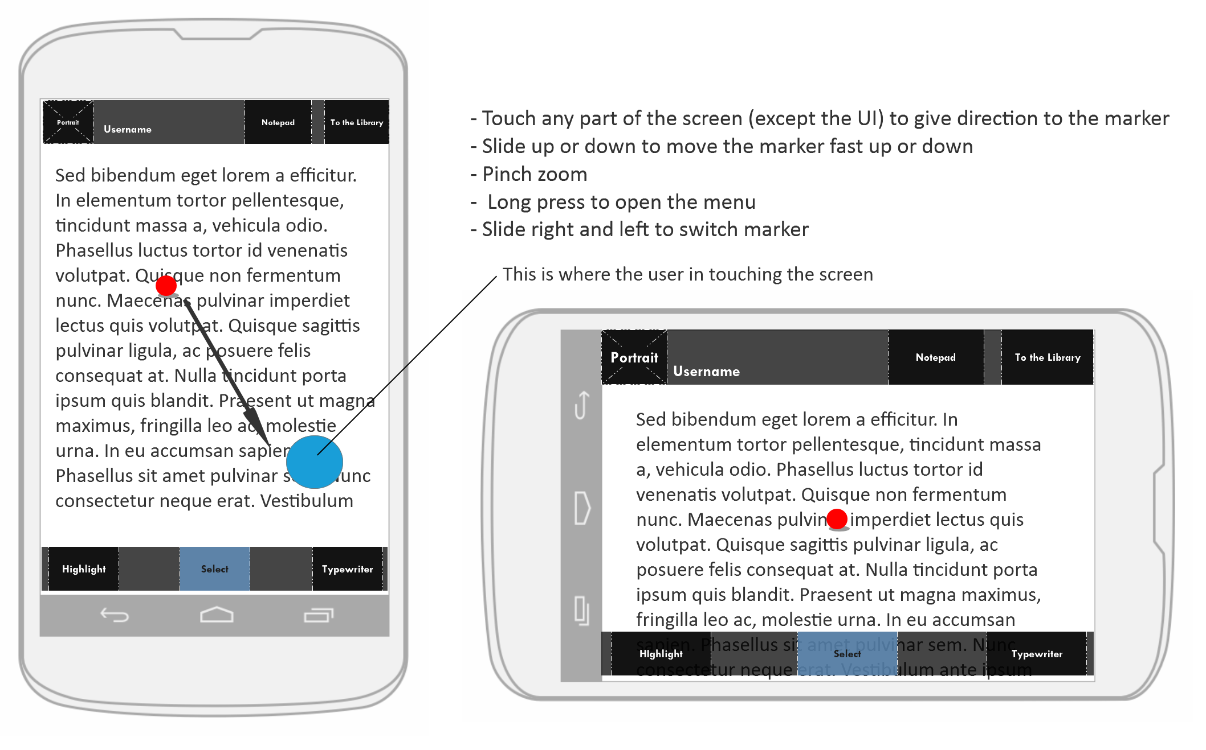
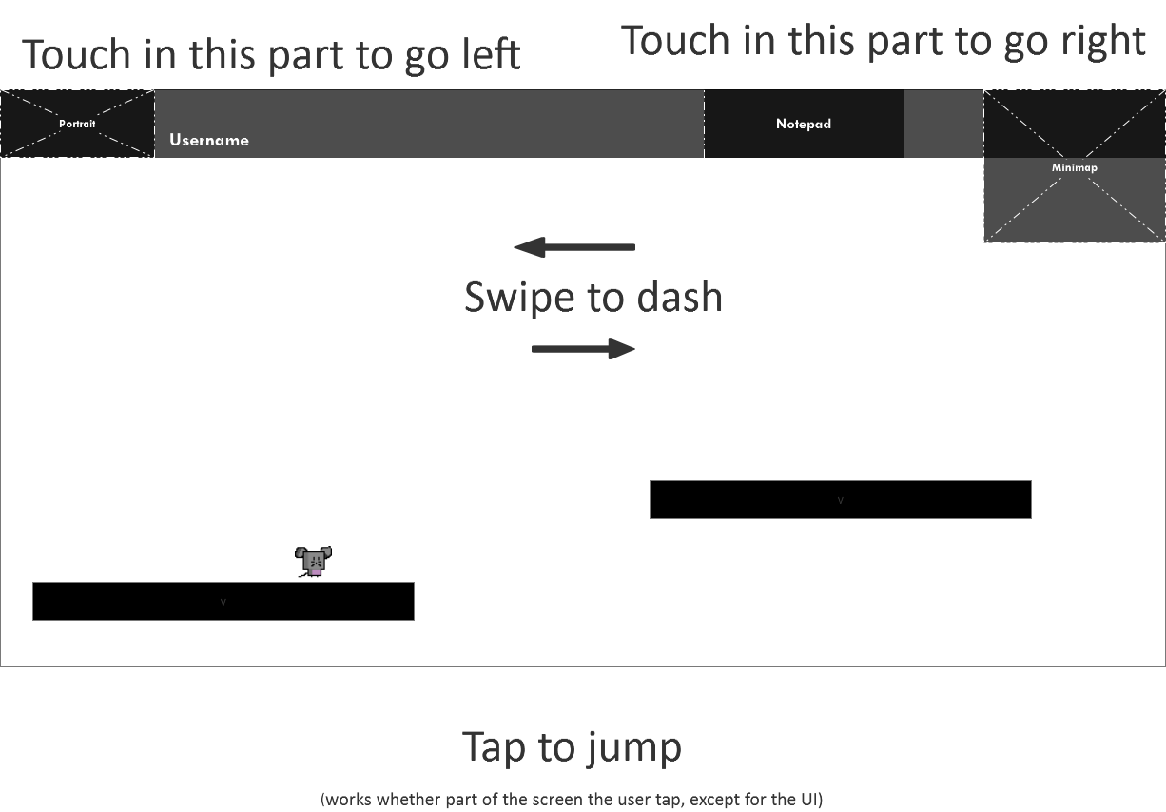
Touch controls Exploration mode
Touch controls
Lecture
mode

Slide 19
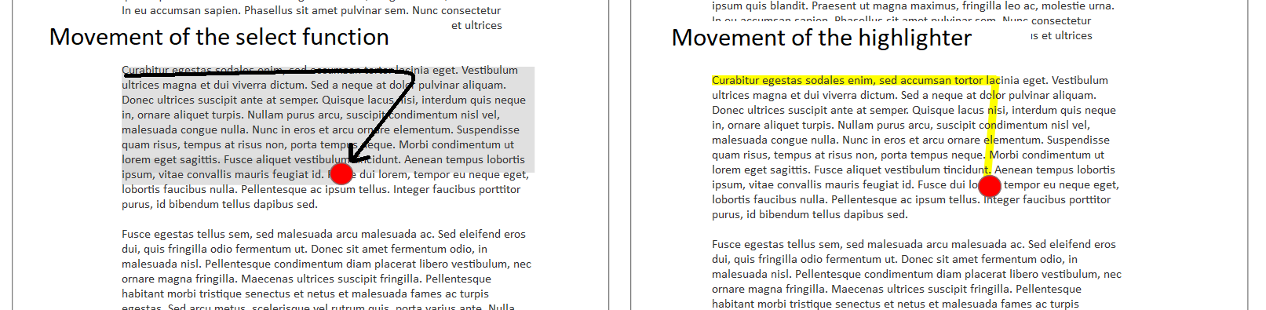

Slide 20
Kinaesthesia
Awareness of the position and movement of the body in space.
Vicarious kinaesthesia
Or «Game Feel»
“the tactile and kinesthetic sense of manipulating and controlling a virtual object”
(Swink, Game Feel: a game designer guide to virtual sensation)

